Slide 1
Notes from tournament week
Earlier in the week we went over the exam (Monday and Tuesday )
Wednesday we revised expected number, variance and standard deviation, including using the GC to simplify variance calculations (workbook p8,9)
Thursday and Friday we looked at “Expectation Algebra”:

Slide 2
We wrote some notes on combining distributions:

Slide 3
We considered the situation where we were rolling a die and spinning the spinner shown. We drew the probability distributions and calculated E(X), Var(X), SD(X). We then looked at how to use expectation algebra to find the expected totals and variances/sds if we added or subtracted the distributions.

Slide 4
We then looked at what happened if we doubled or tripled each value. We found: the expected number got multiplied by the 2 or 3 but the variance got multiplied by 2² or 3² (respectively). This gave the following rules:

Slide 5
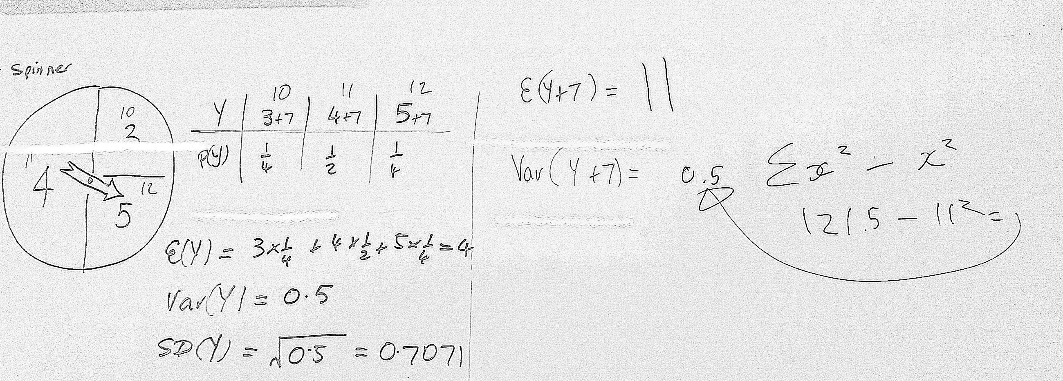
We also looked at what happened if we added 7 to every number on the spinner: we found that the expected number went up by 7, but the variance stayed the same. This makes sense as variance is a measure of spread and the data didn’t get any more or less spread out when EVERY VALUE went up by 7. This gave rise to the rules:

Slide 6
Variance A
Bad Jelly wants to improve the consistency of her ‘randy newt’ potions. She catches families of newts for the potions. The probabilities of finding different newt family sizes are given below:
1) What is the average number of newts caught?
2) Calculate the standard deviation of ‘n’

Slide 7
Variance A Soln
Bad Jelly wants to improve the consistency of her ‘randy newt’ potions. She catches families of newts for the potions. The probabilities of finding different newt family sizes are given below:
1) What is the average number of newts caught?
2) Calculate the standard deviation of ‘n’

Slide 8
Variance B
The number of warts on Bad Jelly’s nose change daily, (each day is independent) with a mean μ of 5.2 and standard deviation σ of 1.3 warts per day. Bad Jelly’s sister Jade is so evil that only a few warts can survive on her nose (μ = 3.4 and σ = 0.8)
One day Bad Jelly and evil Jade count their warts.
1) What is the average total number of warts?
2) What is the standard deviation of the total number of warts?
3) Bad Jelly records the number of warts on her own nose for a week.
What was her expected total (and the standard deviation?)

Slide 9
Variance B Soln
The number of warts on Bad Jelly’s nose change daily, (each day is independent) with a mean μ of 5.2 and standard deviation σ of 1.3 warts per day. Bad Jelly’s sister Jade is so evil that only a few warts can survive on her nose (μ = 3.4 and σ = 0.8)
One day Bad Jelly and evil Jade count their warts.
1) What is the average total number of warts?
2) What is the standard deviation of the total number of warts?
3) Bad Jelly records the number of warts on her own nose for a week.
What was her expected total (and the standard deviation?)

Slide 10
Variance C
Bad Jelly is concerned by her wart problem so she visits the STI clinic (Spells, Tonics & Incantations) and buys two anti-wart potions. The average number of warts a tonic can treat is 5 (variance = 1.4)
Bad Jelly has many warts, so she applies a spell to make one potion three times as strong.
1) What is the expected number of warts the potion can now treat?
(And variance?)
Bad Jelly doubles the strength of the other potion, and then combines the two potions together.
2) What is the expected number of warts the potion can now treat?
(And variance?)

Slide 11
Variance C Soln
Bad Jelly is concerned by her wart problem so she visits the STI clinic (Spells, Tonics & Incantations) and buys two anti-wart potions. The average number of warts a tonic can treat is 5 (variance = 1.4)
Bad Jelly has many warts, so she applies a spell to make one potion three times as strong.
1) What is the expected number of warts the potion can now treat?
(And variance?)
Bad Jelly doubles the strength of the other potion, and then combines the two potions together.
2) What is the expected number of warts the potion can now treat?
(And variance?)

