Slide 1
How to use mathstatic to produce graphs
For year 12 inferences 2.9

Slide 2
Open a web browser and go to…
www.mathstatic.co.nz
(or click on the link above)

Slide 3
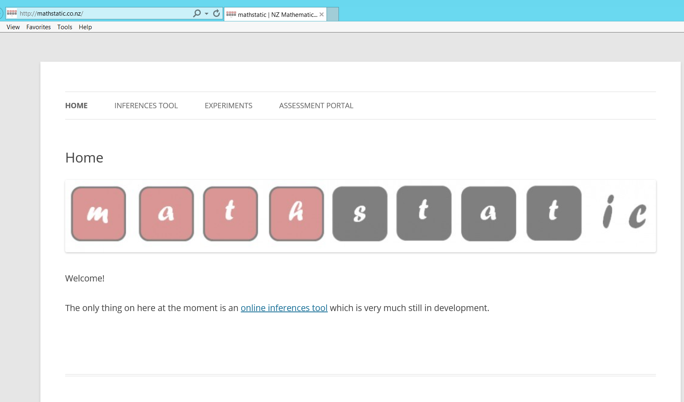
Click on “Inferences tool”

Slide 4
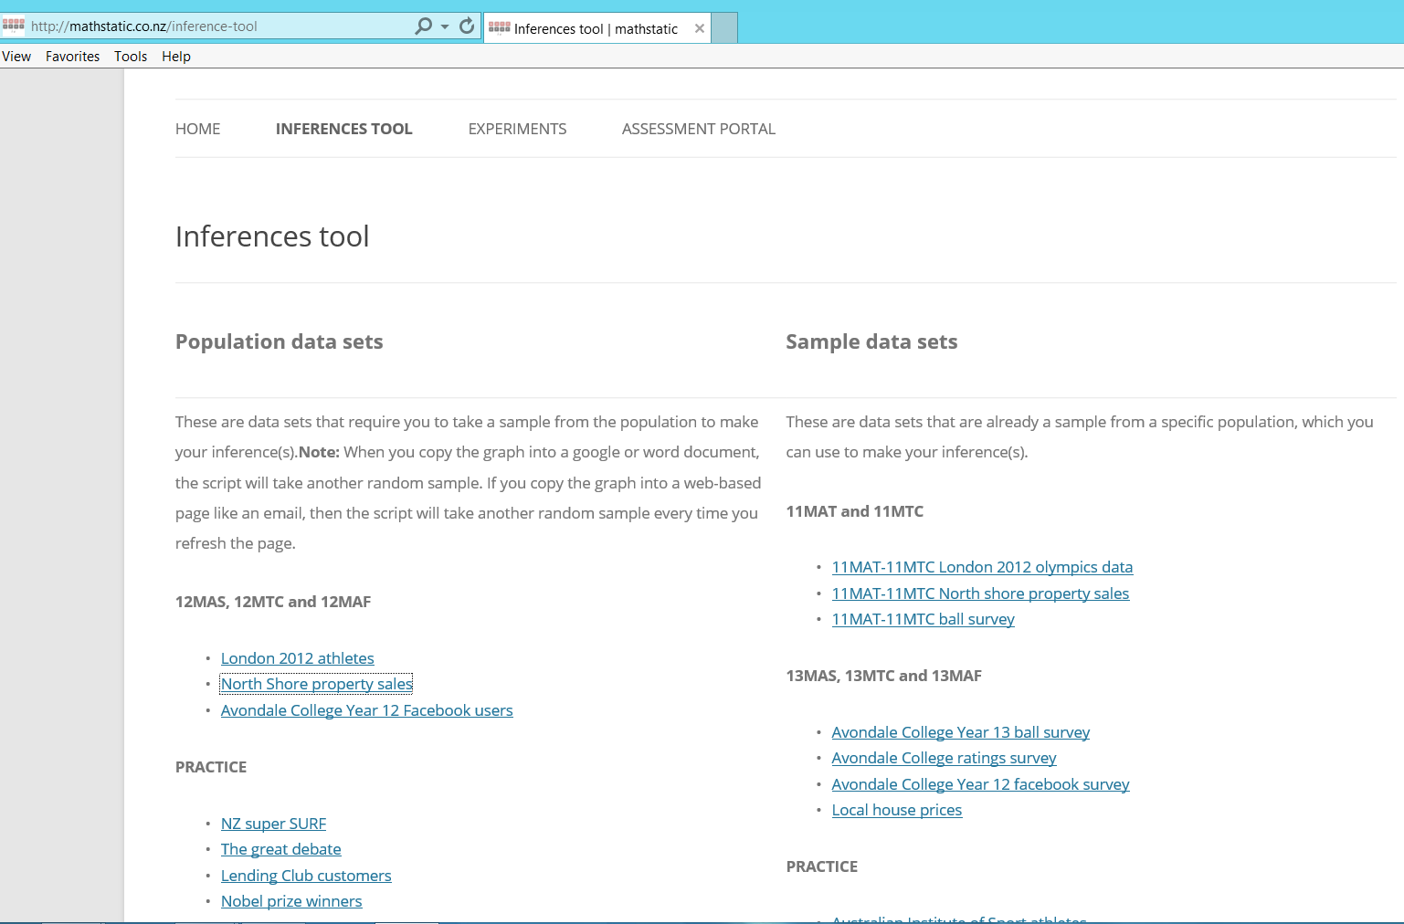
We are only using this part here

Slide 5
For today, click on the great debate data set.
Note, this is the data set for the whole population

Slide 6
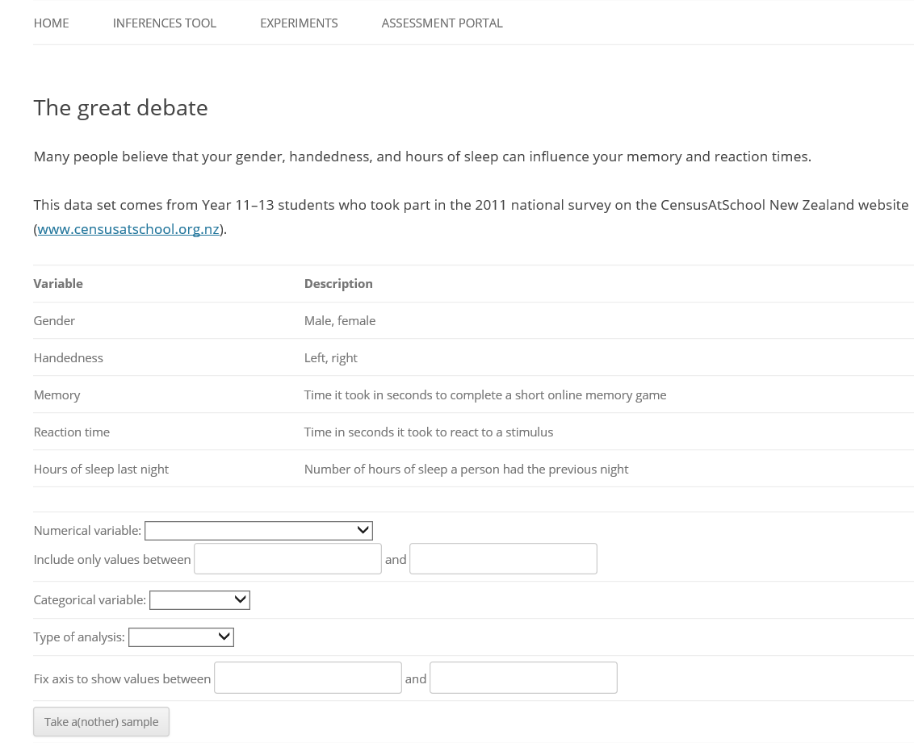
This is what you see…
Some info about the data
The different variables that are in this data set
Where you choose the variables you want to use

Slide 7
Activity!!
Before you go any further, open a word document.
In it, write 4 good comparison statements based on the variables available in this data set
Once you have written your 6 good statements, we are going to produce a random sample for each and produce the graphs for analysis later…

Slide 8
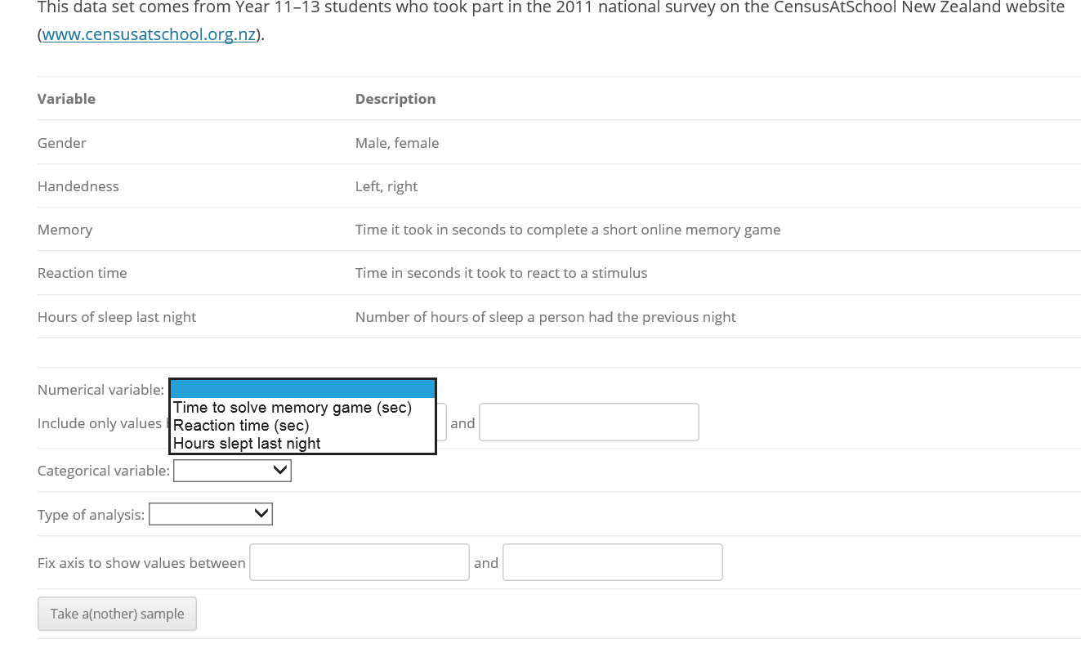
Use the drop down boxes to choose the required variables for each of your questions

Slide 9
Eg) I wonder if the median number of hours slept last night is higher for NZ girls in year 11-13 than it is for NZ boys in year 11-13?
Don’t worry about these boxes. They are just if you want to limit your data range to get rid of outliers – we won’t need to do that this year ☺
As soon as you select your categorical variable, more boxes will drop down

Slide 10
Eg) I wonder if the median number of hours slept last night is higher for NZ girls in year 11-13 than it is for NZ boys in year 11-13?
These are your extra boxes. You now need to pick which categorical variable you want for each box plot (easy here, there are only 2 options, male or female)
Don’t forget to choose your sample size for each too – make sure it is at least 30!!

Slide 11
Eg) I wonder if the median number of hours slept last night is higher for NZ girls in year 11-13 than it is for NZ boys in year 11-13?
The last thing to select is the type of analysis
This year, you always want to choose the year 12 option (gives us the graphs we need for this standard)

Slide 12
Eg) I wonder if the median number of hours slept last night is higher for NZ girls in year 11-13 than it is for NZ boys in year 11-13?
Click “Take a(nother) sample to take your first sample.
If you click the button again, it will give you another sample.
Don’t worry about these boxes.

Slide 13
This is what you get – a random sample of 30 from each group, just like you asked!
Dot plot so you can see the distribution of your sample
Box plots of your sample
It even gives you the 5 point summary!!
Female group
Male group

Slide 14
These red bands and the numbers on top are what called the informal confidence interval (ICI).
We are going to use these a bit later to help us make an inference (conclusion) and help us answer our comparison question.

Slide 15
Right click and copy the graph into your word document under your comparison question
Then, take another random sample just so you can see how it changes.

Slide 16
Now, generate graphs for your other 5 comparison questions
When you finish, print them off. We will use them over the next few lessons to write analysis statements

Slide 17
Now you know how to take a random sample and produce graphs using mathstatic!!

