Slide 1
Inference
Practice for AS2.9

Slide 2
PPDAC - The Problem: I wonder if the median… I expect…

Slide 3
PPDAC The Plan
I will use a computer to select…
Comment on reliability of method:
Comment on size of the sample

Slide 4
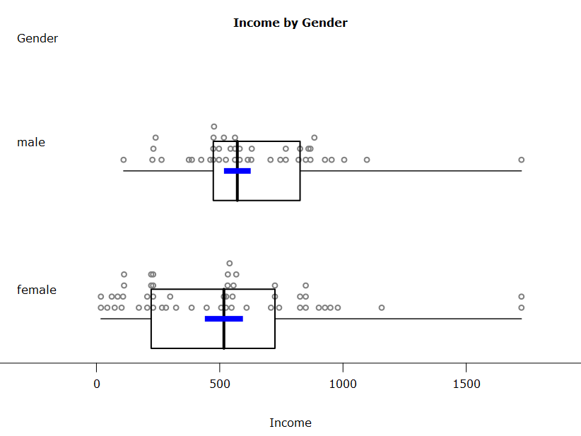
PPDAC - Analysis
What I See:
My dotplots:
My boxplots:
Possible reasons:

Slide 5
PPDAC - Analysis
Calculations:
My informal confidence interval for the females’ incomes:
My inference:

Slide 6
PPDAC - Analysis
Calculations:
My informal confidence interval for the males’ incomes:
My inference:

Slide 7
PPDAC – Conclusion
Answer to question + justification:

Slide 8
PPDAC – Conclusion
Comment on sampling variablilty

Slide 9
PPDAC – Conclusion
Comment on effect of sample size

Slide 10
PPDAC – Conclusion
Further comments integrating contextual and statistical knowledge throughout the statistical enquiry cycle

Slide 11
PPDAC – Conclusion
Further comments, eg, on limiting factors in the definition of the groups, or the impact of other factors on the reliability of estimates.

