Slide 1
Venn Diagrams with Probability

Slide 2
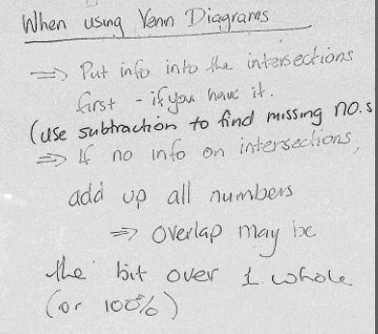
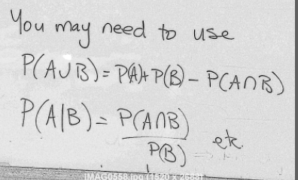
Notes from last week
$$Also – if events are independent :P\left(A∩B\right)=P\left(A\right)×P(B)$$

Slide 3
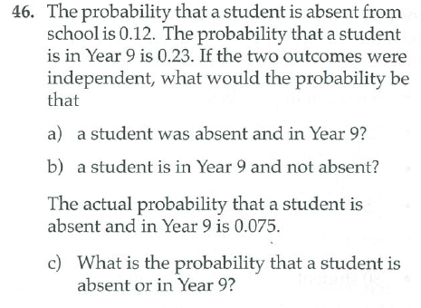

Slide 4
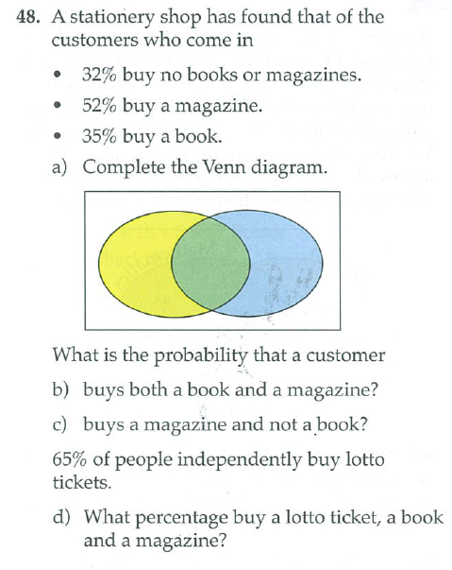

Slide 5
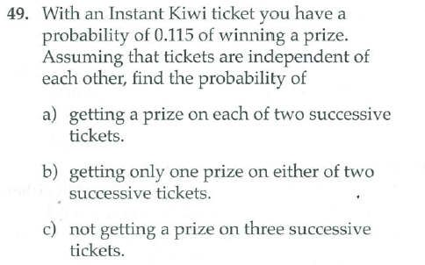

Slide 6
