Slide 1
Year 11
Statistics – Bivariate
Collection a sample of data to make decisions about relationships in a population.

Slide 2
PPDAC Defining the Problem
This is where you write a brief introduction to your topic – who would be interested in knowing about this and why.
Define your population clearly!
Decide what variables you will investigate (the variables will be measurements like height, length, weight etc)
Write your “question” or “I wonder statement”
Eg. I wonder if there is a relationship between the head circumference in cm and the height in cm of year 11 WGHS students.
Write your hypothesis: I expect …

Slide 3
PPDAC the Plan
This is where you write a few sentences about what you plan to do next.
How will you gather the data? (eg measure with a ruler, weigh with scales…)
How will you record your results – in a table? In a spreadsheet?
What measurement system will you use? (eg mm, cm, g, L etc)

Slide 4
PPDAC the Data Section
This is where you check that your data values are sensible, commenting on any obvious outliers
Are they clear mistakes? → can they be fixed? Or should you remove?
Or, are they an important special case which should be kept?

Slide 5
PPDAC Analysis
This is where you create your graphs and calculate statistical values.
You will draw a scattergraph or scatterplot to look for a relationship.
You will then need to write sentences about what the graph shows.
TASgu can help you remember the things you need to write about:

Slide 6
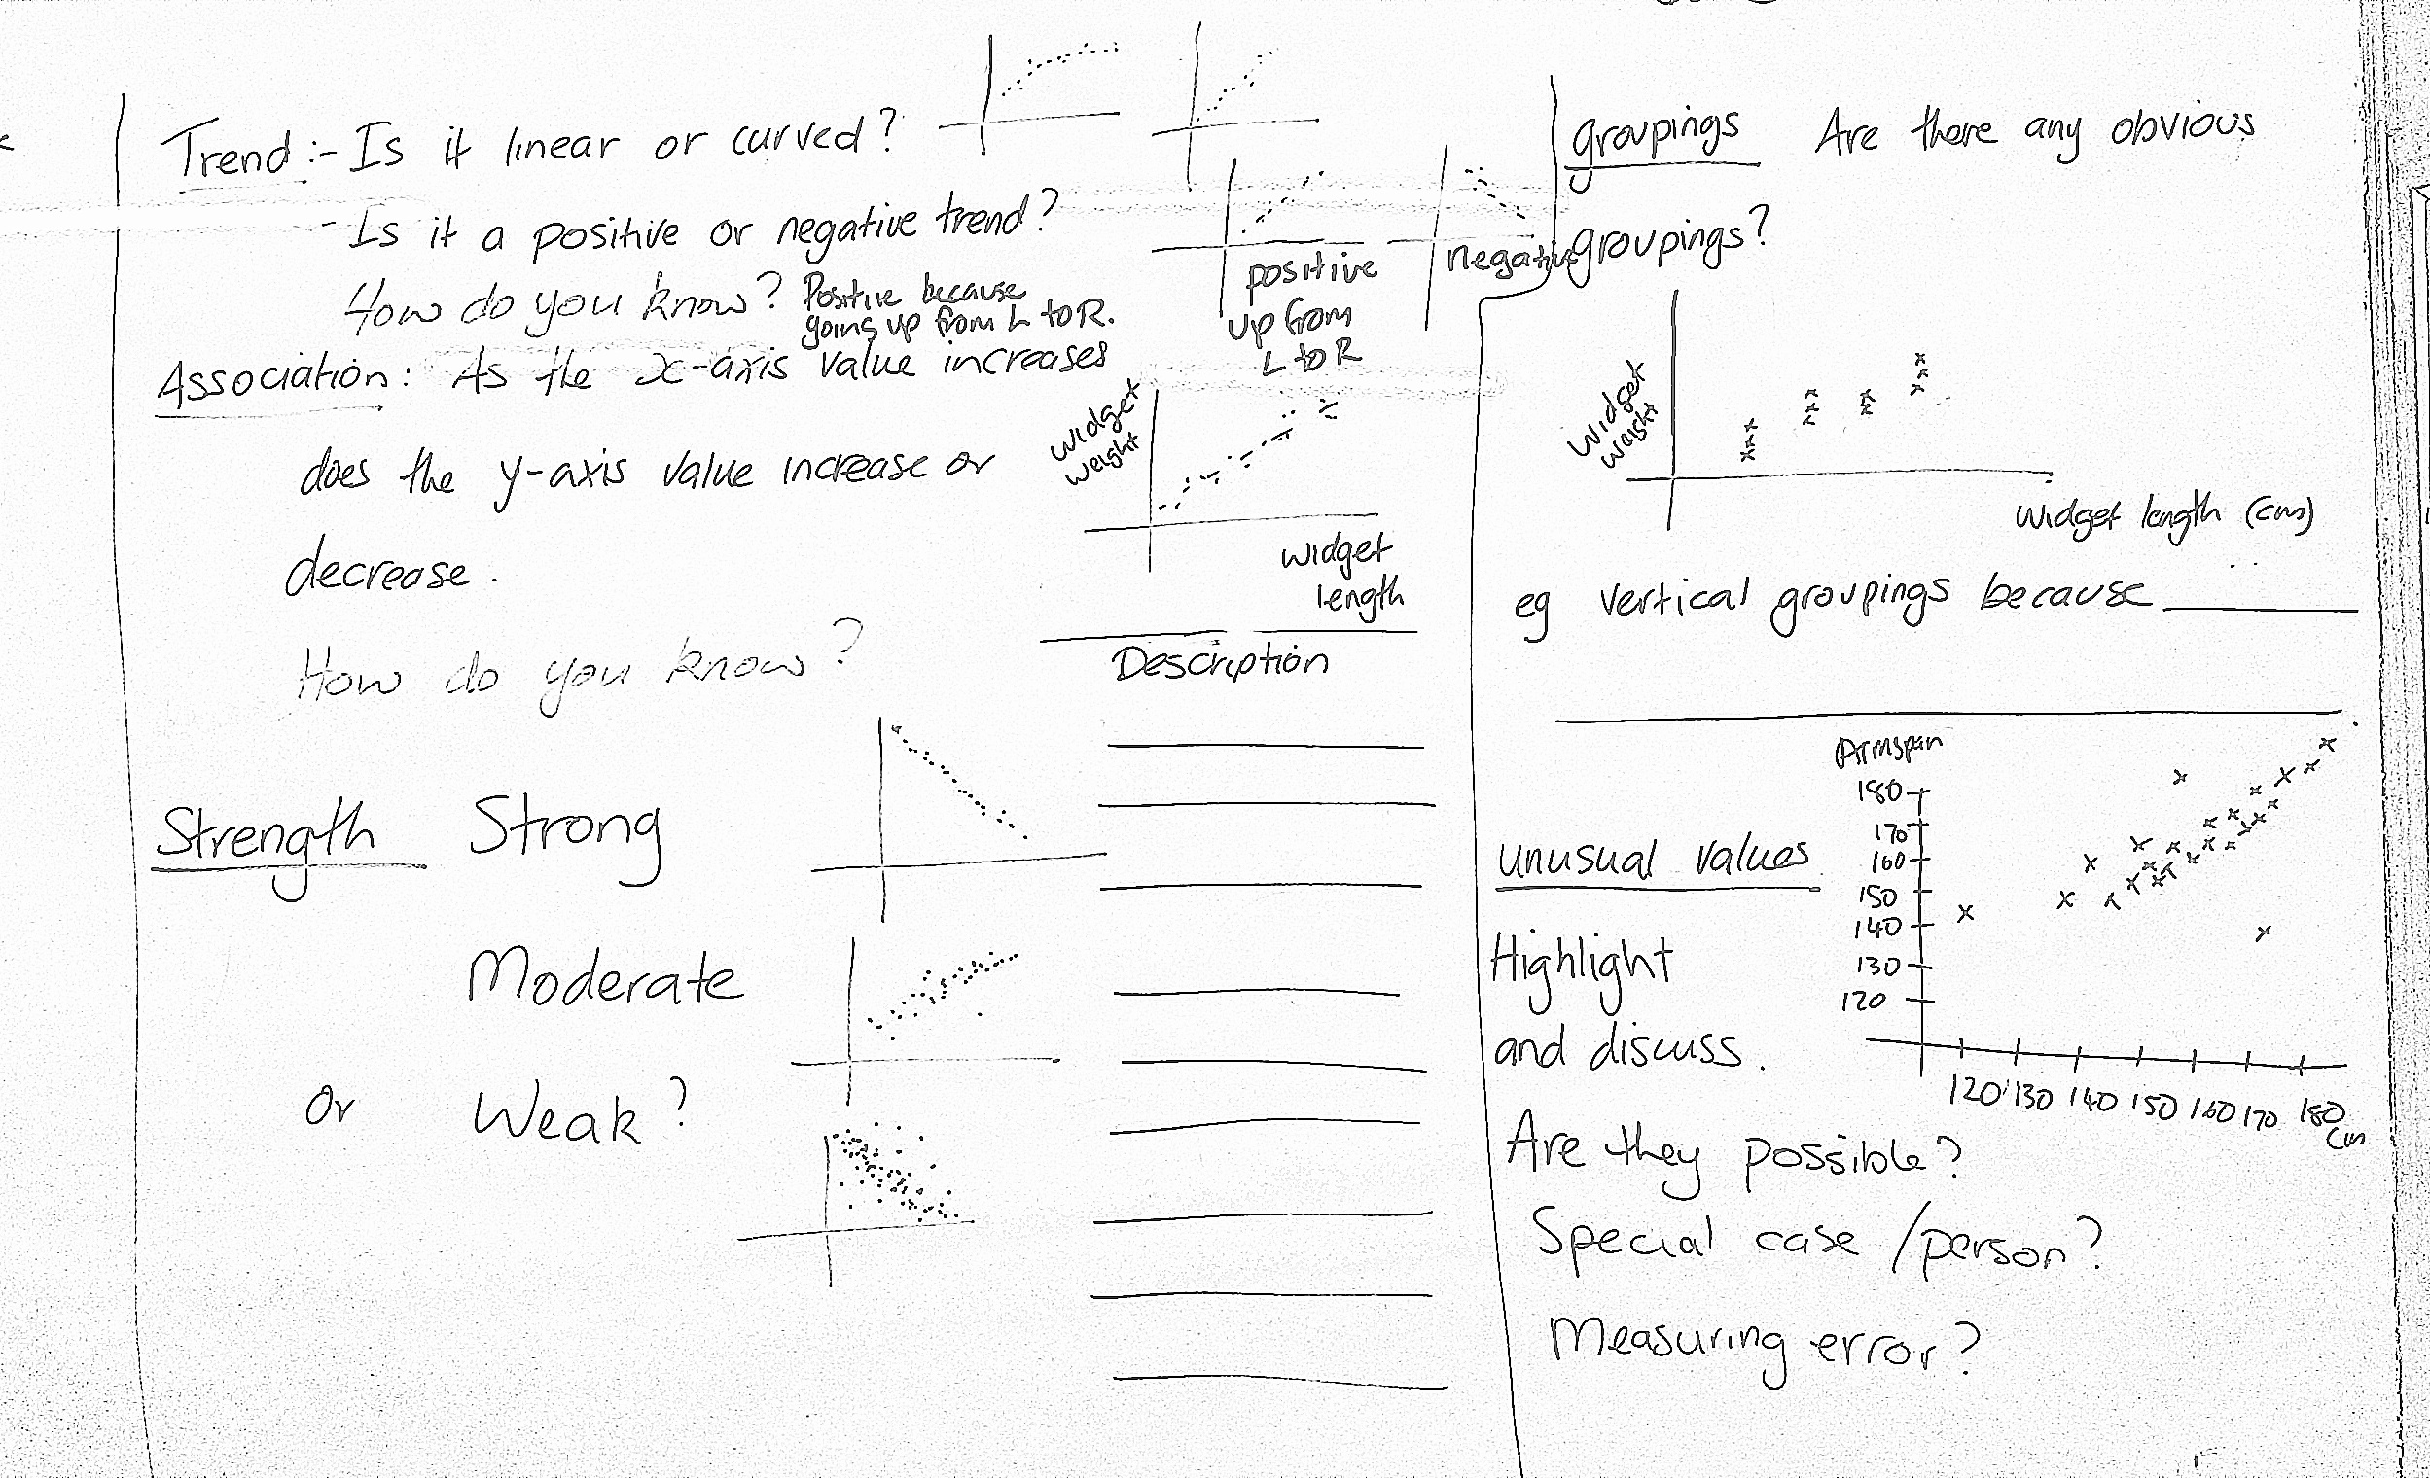

Slide 8
PPDAC Conclusion
This is where you summarise your findings
Answer your question
Comment on your hypothesis.
Comment on whether it is appropriate to relate your answers back to a wider
population.
(extra for exc.) Comment on the meaning of the gradient and/or correlation measure.

